Slide 1
Module 17: Distributed-File Systems
Background
Naming and Transparency
Remote File Access
Stateful versus Stateless Service
File Replication
Example Systems

Slide 2
Background
Distributed file system (DFS) – a distributed implementation of the classical time-sharing model of a file system, where multiple users share files and storage resources.
A DFS manages set of dispersed storage devices
Overall storage space managed by a DFS is composed of different, remotely located, smaller storage spaces.
There is usually a correspondence between constituent storage spaces and sets of files.

Slide 3
DFS Structure
Service – software entity running on one or more machines and providing a particular type of function to a priori unknown clients.
Server – service software running on a single machine.
Client – process that can invoke a service using a set of operations that forms its client interface.
A client interface for a file service is formed by a set of primitive file operations (create, delete, read, write).
Client interface of a DFS should be transparent, i.e., not distinguish between local and remote files.

Slide 4
Naming and Transparency
Naming – mapping between logical and physical objects.
Multilevel mapping – abstraction of a file that hides the details of how and where on the disk the file is actually stored.
A transparent DFS hides the location where in the network the file is stored.
For a file being replicated in several sites, the mapping returns a set of the locations of this file’s replicas; both the existence of multiple copies and their location are hidden.

Slide 5
Naming Structures
Location transparency – file name does not reveal the file’s physical storage location.
  File name still denotes a specific, although hidden, set of physical disk blocks.
  Convenient way to share data.
  Can expose correspondence between component units and machines.
Location independence – file name does not need to be changed when the file’s physical storage location changes.
  Better file abstraction.
  Promotes sharing the storage space itself.
  Separates the naming hierarchy form the storage-devices hierarchy.

Slide 6
Naming Schemes — Three Main Approaches
Files named by combination of their host name and local name; guarantees a unique systemwide name.
Attach remote directories to local directories, giving the appearance of a coherent directory tree; only previously mounted remote directories can be accessed transparently
Total integration of the component file systems.
  A single global name structure spans all the files in the system.
  If a server is unavailable, some arbitrary set of directories on different machines also becomes unavailable. .

Slide 7
Remote File Access
Reduce network traffic by retaining recently accessed disk blocks in a cache, so that repeated accesses to the same information can be handled locally..
  If needed data not already cached, a copy of data is brought from the server to the user.
  Accesses are performed on the cached copy.
  Files identified with one master copy residing at the server machine, but copies of (parts of) the file ar scattered in different caches.
  Cache-consistency problem – keeping the cached copies consistent with the master file.

Slide 8
Location – Disk Caches vs. Main Memory Cache
Advantages of disk caches
  More reliable.
  Cached data kept on disk are still there during recovery and don’t need to be fetched again.
Advantages of main-memory caches:
  Permit workstations to be diskless.
  Data can be accessed more quickly.
  Performance speedup in bigger memories.
  Server caches (used to speed up disk I/O) are in main memory regardless of where user caches are located; using main-memory caches on the user machine permits a single caching mechanism for servers and users.

Slide 9
Cache Update Policy
Write-through – write data through to disk as soon as they are placed on any cache. Reliable, but poor performance.
Delayed-write – modifications written to the cache and then written through to the server later. Write accesses complete quickly; some data may be overwritten before they are written back, and so need never be written at all.
  Poor reliability; unwritten data will be lost whenever a user machine crashes.
  Variation – scan cache at regular intervals and flush blocks that have been modified since the last scan.
  Variation – write-on-close, writes data back to the server when the file is closed. Best for files that are open for long periods and frequently modified.

Slide 10
Consistency
Is locally cached copy of the data consistent with the master copy?
Client-initiated approach
  Client initiates a validity check.
  Server checks whether the local data are consistent with the master copy.
Server-initiated approach
  Server records, for each client, the (parts of) files it caches.
  When server detects a potential inconsistency, it must react.

Slide 11
Comparing Caching and Remote Service
In caching, many remote accesses handled efficiently by the local cache; most remote accesses will be served as fast as local ones.
Servers are contracted only occasionally in caching (rather than for each access).
  Reduces server load and network traffic.
  Enhances potential for scalability.
Remote server method handles every remote access across the network; penalty in network traffic, server load, and performance.
Total network overhead in transmitting big chunks of data (caching) is lower than a series of responses to specific requests (remote-service).

Slide 12
Caching and Remote Service (Cont.)
Caching is superior in access patterns with infrequent writes. With frequent writes, substantial overhead incurred to overcome cache-consistency problem.
Benefit from caching when execution carried out on machines with either local disks or large main memories.
Remote access on diskless, small-memory-capacity machines should be done through remote-service method.
In caching, the lower intermachine interface is different form the upper user interface.
In remote-service, the intermachine interface mirrors the local user-file-system interface.

Slide 13
Stateful File Service
Mechanism.
  Client opens a file.
  Server fetches information about the file from its disk, stores it in its memory, and gives the client a connection identifier unique to the client and the open file.
  Identifier is used for subsequent accesses until the session ends.
  Server must reclaim the main-memory space used by clients who are no longer active.
Increased performance.
  Fewer disk accesses.
  Stateful server knows if a file was opened for sequential access and can thus read ahead the next blocks.

Slide 14
Stateless File Server
Avoids state information by making each request self-contained.
Each request identifies the file and position in the file.
No need to establish and terminate a connection by open and close operations.

Slide 15
Distinctions Between Stateful & Stateless Service
Failure Recovery.
  A stateful server loses all its volatile state in a crash.
    Restore state by recovery protocol based on a dialog with clients, or abort operations that were underway when the crash occurred.
    Server needs to be aware of client failures in order to reclaim space allocated to record the state of crashed client processes (orphan detection and elimination).
  With stateless server, the effects of server failure sand recovery are almost unnoticeable. A newly reincarnated server can respond to a self-contained request without any difficulty.

Slide 16
Distinctions (Cont.)
Penalties for using the robust stateless service:
  longer request messages
  slower request processing
  additional constraints imposed on DFS design
Some environments require stateful service.
  A server employing server-initiated cache validation cannot provide stateless service, since it maintains a record of which files are cached by which clients.
  UNIX use of file descriptors and implicit offsets is inherently stateful; servers must maintain tables to map the file descriptors to inodes, and store the current offset within a file.

Slide 17
File Replication
Replicas of the same file reside on failure-independent machines.
Improves availability and can shorten service time.
Naming scheme maps a replicated file name to a particular replica.
  Existence of replicas should be invisible to higher levels.
  Replicas must be distinguished from one another by different lower-level names.
Updates – replicas of a file denote the same logical entity, and thus an update to any replica must be reflected on all other replicas.
Demand replication – reading a nonlocal replica causes it to be cached locally, thereby generating a new nonprimary replica.

Slide 18
The Sun Network File System (NFS)
An implementation and a specification of a software system for accessing remote files across LANs (or WANs).
The implementation is part of the SunOS operating system (version of 4.2BSD UNIX), running on a Sun workstation using an unreliable datagram protocol (UDP/IP protocol and Ethernet.

Slide 19
NFS (Cont.)
Interconnected workstations viewed as a set of independent machines with independent file systems, which allows sharing among these file systems in a transparent manner.
  A remote directory is mounted over a local file system directory. The mounted directory looks like an integral subtree of the local file system, replacing the subtree descending from the local directory.
  Specification of the remote directory for the mount operation is nontransparent; the host name of the remote directory has to be provided. Files in the remote directory can then be accessed in a transparent manner.
  Subject to access-rights accreditation, potentially any file system (or directory within a file system), can be mounted remotely on top of any local directory.

Slide 20
NFS (Cont.)
NFS is designed to operate in a heterogeneous environment of different machines, operating systems, and network architectures; the NFS specifications independent of these media.
This independence is achieved through the use of RPC primitives built on top of an External Data Representation (XDR) protocol used between two implementation-independent interfaces.
The NFS specification distinguishes between the services provided by a mount mechanism and the actual remote-file-access services.

Slide 21
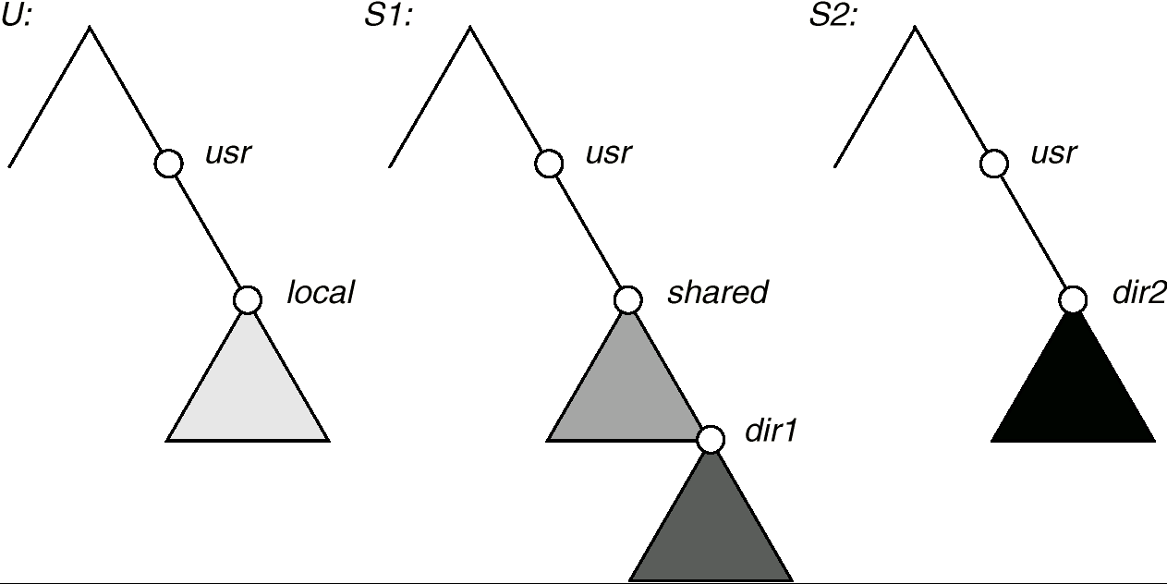
Three Independent File Systems

Slide 22
NFS Mount Protocol
Establishes initial logical connection between server and client.
Mount operation includes name of remote directory to be mounted and name of server machine storing it.
  Mount request is mapped to corresponding RPC and forwarded to mount server running on server machine.
  Export list – specifies local file systems that server exports for mounting, along with names of machines that are permitted to mount them.
Following a mount request that conforms to its export list, the server returns a file handle—a key for further accesses.
File handle – a file-system identifier, and an inode number to identify the mounted directory within the exported file system.
The mount operation changes only the user’s view and does not affect the server side.

Slide 23
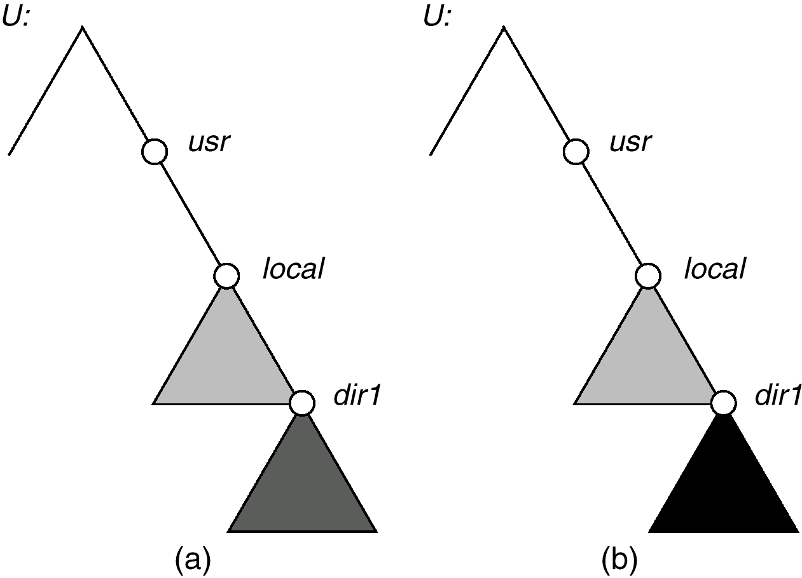
Mounting in NFS
Mounts
Cascading mounts

Slide 24
NFS Protocol
Provides a set of remote procedure calls for remote file operations. The procedures support the following operations:
  searching for a file within a directory
  reading a set of directory entries
  manipulating links and directories
  accessing file attributes
  reading and writing files
NFS servers are stateless; each request has to provide a full set of arguments.
Modified data must be committed to the server’s disk before results are returned to the client (lose advantages fo caching).
The NFS protocol does not provide concurrency-control mechanisms.

Slide 25
Three Major Layers of NFS Architecture
UNIX file-system interface (based on the open, read, write, and close calls, and file descriptors).
Virtual File System (VFS) layer – distinguishes local files from remote ones, and local files are further distinguished according to their file-system types.
  The VFS activates file-system-specific operations to handle local requests according to their file-system types.
  Calls the NFS protocol procedures for remote requests.
NFS service layer – bottom layer of the architecture; implements the NFS protocol.

Slide 26
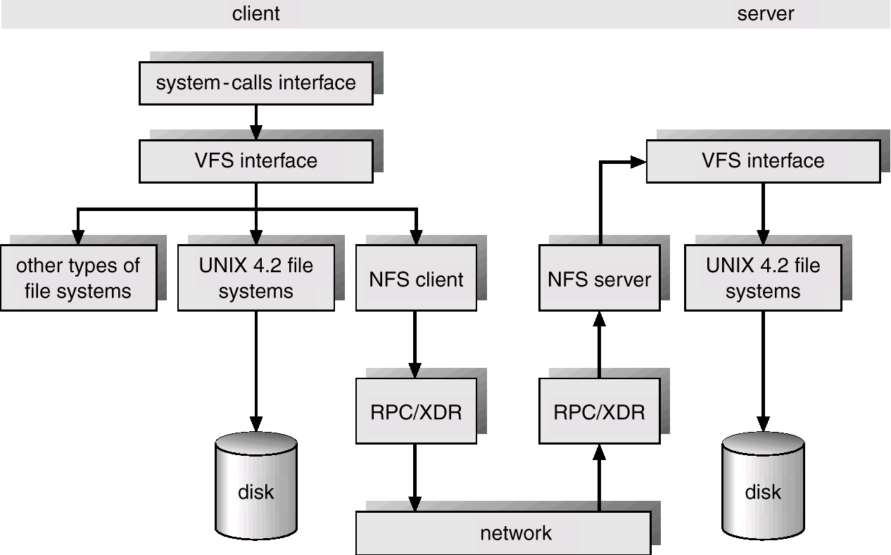
Schematic View of NFS Architecture

Slide 27
NFS Path-Name Translation
Performed by breaking the path into component names and performing a separate NFS lookup call for every pair of component name and directory vnode.
To make lookup faster, a directory name lookup cache on the client’s side holds the vnodes for remote directory names.

Slide 28
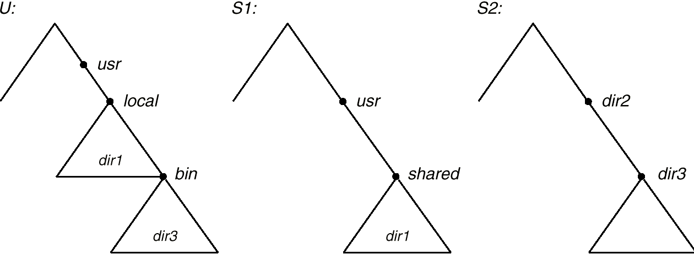
Path-name Translation

Slide 29
NFS Remote Operations
Nearly one-to-one correspondence between regular UNIX system calls and the NFS protocol RPCs (except opening and closing files).
NFS adheres to the remote-service paradigm, but employs buffering and caching techniques for the sake of performance.
File-blocks cache – when a file is opened, the kernel checks with the remote server whether to fetch or revalidate the cached attributes. Cached file blocks are used only if the corresponding cached attributes are up to date.
File-attribute cache – the attribute cache is updated whenever new attributes arrive from the server.
Clients do not free delayed-write blocks until the server confirms that the data have been written to disk.

